Slide 1


Linear Regression Model on Preowned Ford Cars
-Yamini Dakuri

Slide 2

INTRODUCTION:
  So, I have taken a data set of ford used
  cars with different car models which will
  be repurchased by the customers in the
  future.
  Financially feasible to the customers.
  Plenty of options with good features.

Slide 3

PROBLEM STATEMENT:
  I’m going to analyze how the other variables affect the price of the Pre-owned ford cars in order to predict the future purchases.
  Challenging factor for both the customers and the sellers.
  Finding out the true price value for the cars.

Slide 4

MOTIVATION:
  Main advantages of used car is that you select the car that comes under your budget and fulfill your necessities.
  Already demonstrated, examined and considered as more authoritative.
  No exaggerated fee
  Student friendly
  Lower insurance rate.

Slide 5
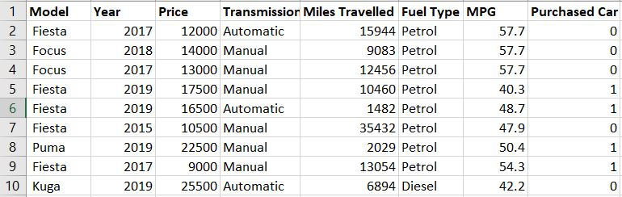
DATA SET:
  Dependent variable Price
  Rest are the independent variables

Slide 6
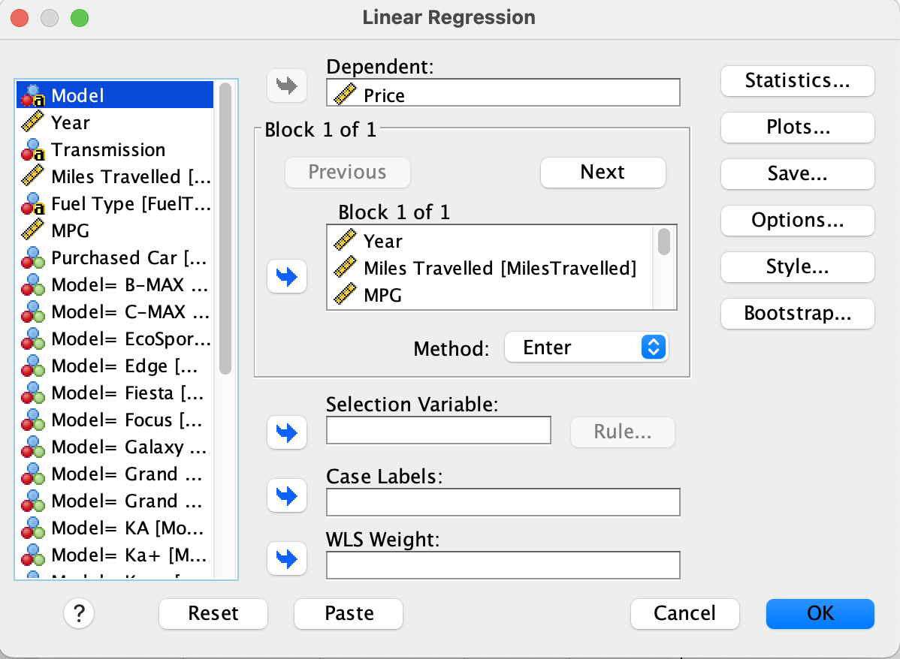
METHODOLOGY:
Linear regression model in SPSS.
(Y = a + b1X1 + b2X2 + ... + bnXn)
Variables: Price is the dependent variable, Rest are the independent variables given in the data set.
Dummy variables: Model, Fuel Type, Transmission.

Slide 7
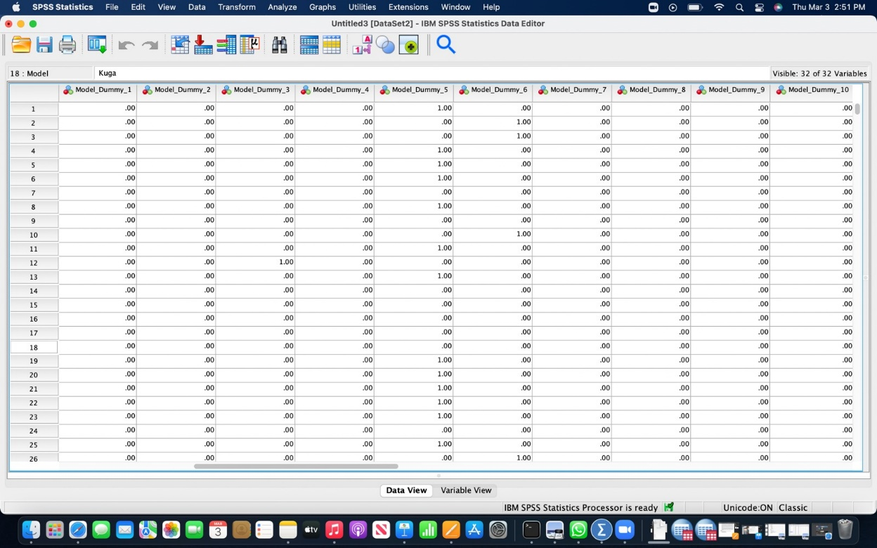
Dummy variables

Slide 8
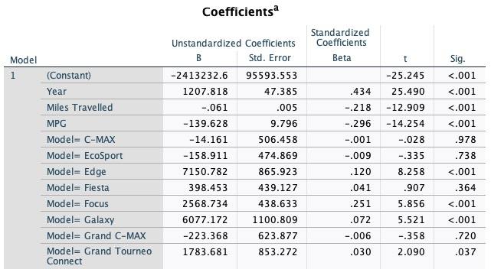
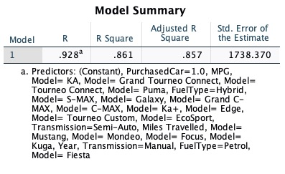
RESULT:
After running the linear regression model in SPSS
Here is the result reference,
Y = -2413232.6 + 1207.81(Year) – 0.061(Miles travelled) ............ + bnXn)

Slide 9
DISCUSSION:
Data:
1000 entries
Year ranges from 2013-2020
18 models, 3 Transmission type, 3 fuel types
Outcome:
From the result shown i observed that R Square value is 86.1% efficient
Some of the variables are statistically significant to the Model.

Slide 10
CONCLUSION:
From the outcome I conclude that the few models such as; Mustang, Puma, Kuga, S-Max, Galaxy, Focus, Edge are highly significant.
(15 variables are significant).
With the decrease of the Price, MPG is increasing, we see that these two variables are correlated.
Similarly, Increase of the years model, the price also increases

Slide 11
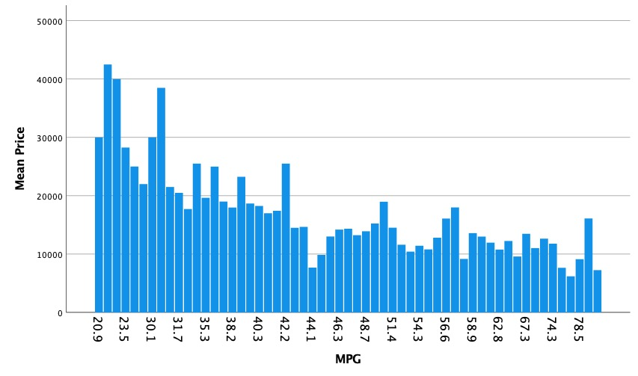
Bar graphs:
MPG is X axis
Mean Price is Y axis

Slide 12
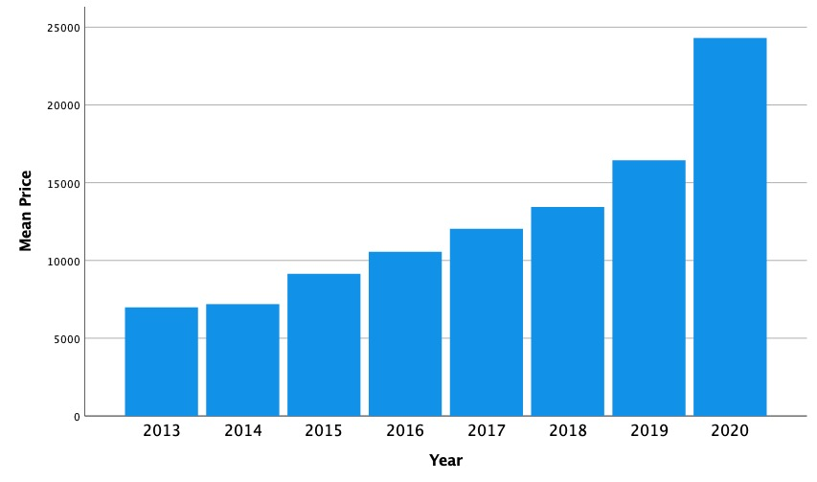
Bar graphs:
Year is X axis
Price is Y axis

Slide 13

PRESCRIPTIVE ANALYSIS:
Based on our understanding, how the other variables effecting the price.
I observe LP predicts that the model Edge, Mustang and S- Max have been purchased often when compare to other models. So, I could analyze in the future that most likely there can be more purchases for these types of Models
Therefore, to increase the sales with better price range ford should consider the variables such as MPG, Transmission, Fuel type.

Slide 14
THANK YOU!

